Slide 1



Slide 2
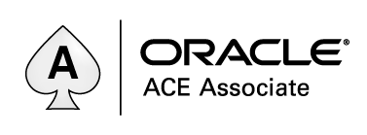
Apex Test Automation
Simon Hunt
Angela Markwick

Slide 3
Session Outcomes
Where to go to find Out More
What the Apex Test Automation Framework (ATAF) is
Why You Need It
What It Does
How it Works
Future Aspirations
Confused, Cant See, Please Ask!

Slide 4
How Can I Find Out More?
www.apextestautomation.co.uk
Have A Go
Documentation
Read the User Guide
Presentation
Get in touch - simon@apextestautomation.co.uk

Slide 5
Small Print
Open Source MIT Licence
Code, Ideas and Documentation only
Self Support – It’s APEX
Selenium IDE not supported in FF55+
Downgrade to FF54
Use alternative runners, Ghost Inspector, SideeX, E2E, Kantu, IMcro
Other Test Frameworks are Available
Test Architect, Leaptest etc

Slide 6
What Is ATAF?
It’s …
A Test Framework
An Apex Application built Apex
A “Low Code” Script Development Tool
An Open Source Project (MIT License)
Uses Selenium IDE to Manually Run Scripts
Uses Web Services to Pushes Scripts to a Cloud Test Grid

Slide 7
Agile Tips
Make Sure ….
Repetition in automated
Backlog Items can stand alone
Tasks duration is less than a day
WIP Limits are respected
Component exports and build options are used
A formal methodology is used
The backlog is managed using an Agile tools

Slide 8
What Is Selenium?
It’s …
A Browser Automation tool
An Open Source Project
A Firefox Plugin (Selenium IDE)

Slide 9
What Does It Do?
It …
Can Design and Build Test Automation Scripts
Integrates with Continuous Integration Platforms
Integrates with Cloud Testing Environments
Supports Test Driven Development
Supports Data Driven Testing
Produces UAT Scripts
Provides Test Reports

Slide 10
How Does It Do It?
It …
Combines Actions, Page Items and Data to generate Scripts
Uses Apex Workspace Views for a UI Map of Page Items
Uses Apex Functionality to build Test Data
Uses Apex Functionality to manage an Action Library
Uses Selenium IDE to Manually Run Scripts
Uses Web Services to Pushes Scripts to a Cloud Test Grid

Slide 11
How Does It Work?
ERD
Project / Specification / Case / Condition
Running Scripts
Test Driven Development
Data Driven Testing
UAT Scripts
Reports

Slide 12



Project
Selenium
Test Suite
Script
Test Specification
Selenium
Test Case
Scripts
Test Case
Test Condition
Test?
Action
Page Item
Value
Action Library
Apex Views
Test Data
Loaded Data
Selenium
Notes:
The application URD
Start point is the Test which comprises an Action, Page Item and Value
The Action is fed from a library of actions, which vary based on the underlying technology and application theme.
The page item is drawn from the Apex views:
List Items
Nav Bar
Page Items
Buttons
Tabs
Table Columns
IR Components
Custom Items
Outcomes
Data is dynamically generated or fed from loaded data
This becomes the test configuration
Multiple test configurations become a test case
These are organised into suites and linked to projects
The Test Suite generates a selenium script
As do the test cases.

Slide 13
Project / Specification / Case / Condition
Project
Test Specification
Test Case
Test Condition
Notes:
Project / Specification / Case / Condition

Slide 14
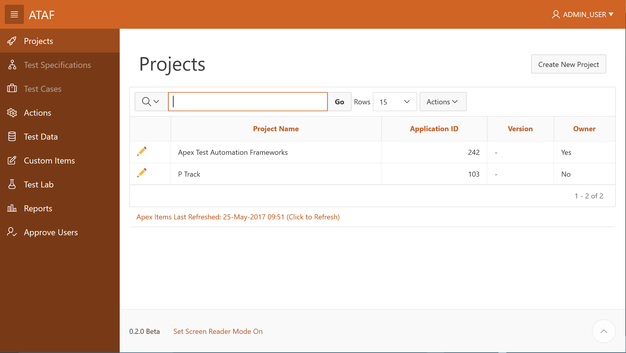
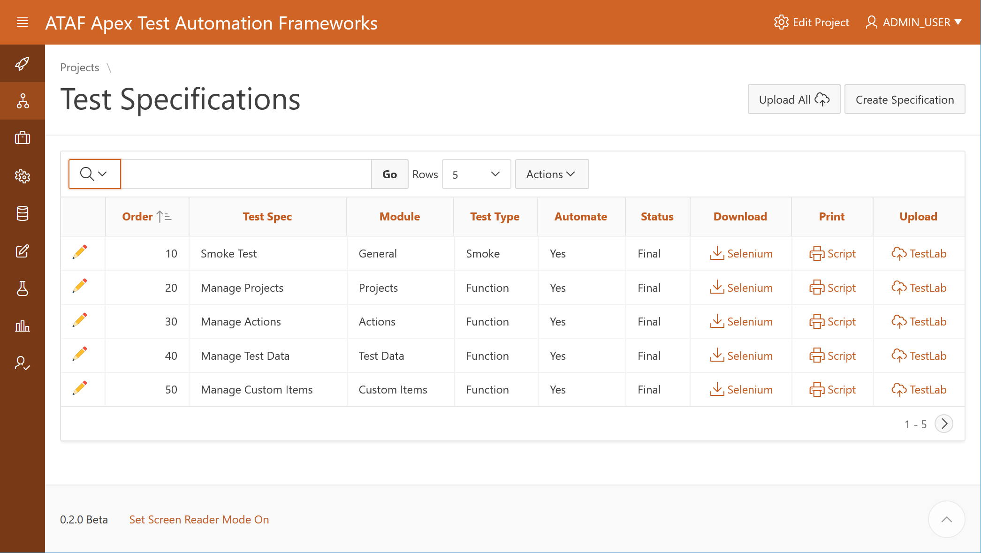
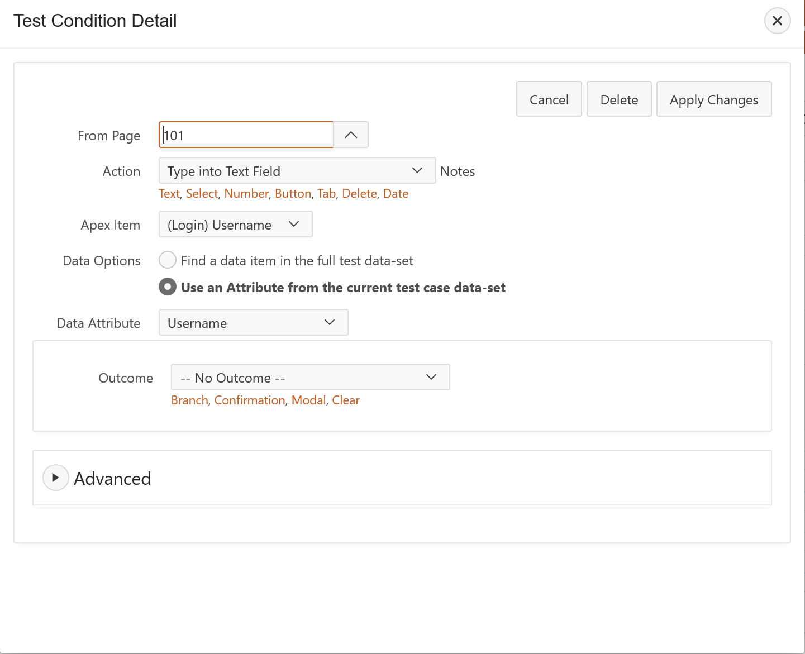
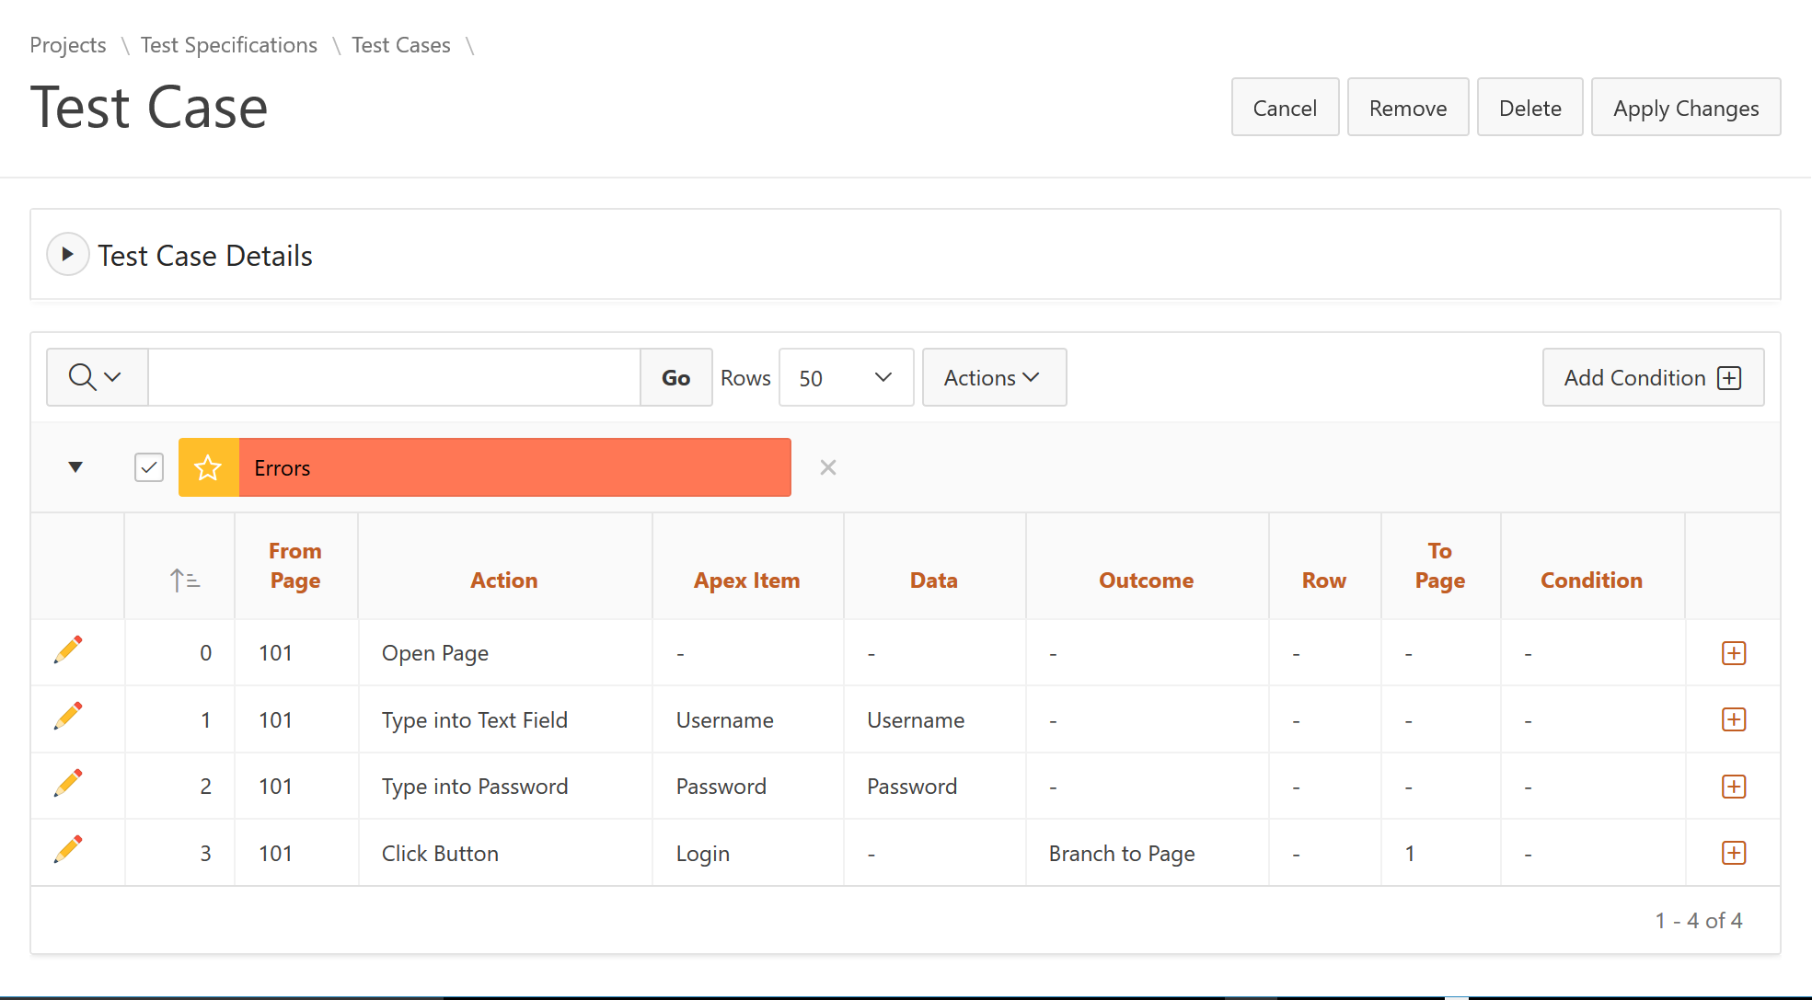
Project / Specification / Case / Condition
Project
Test Specification
Test Case
Test Condition
Notes:
Project / Specification / Case / Condition

Slide 15



Running Scripts Manually
Project
Selenium
Test Suite
Script
Test Specification
Test Case
Downloads
Test Condition
Notes:
Running Scripts - Local

Slide 16
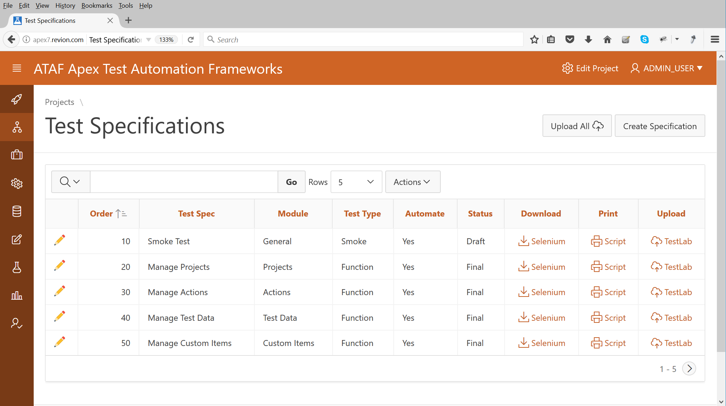
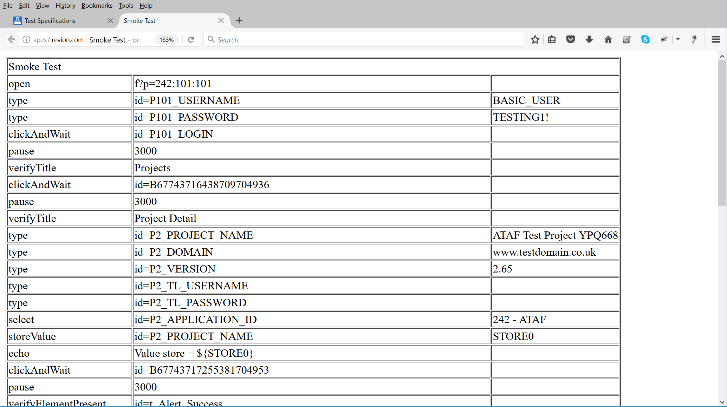
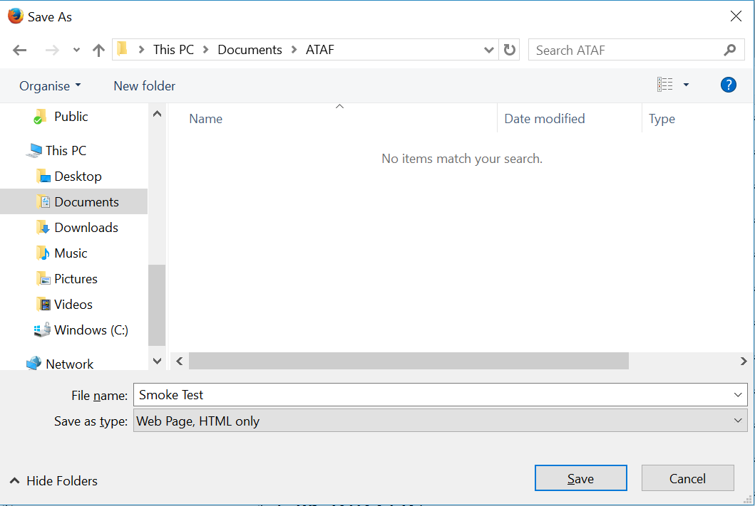
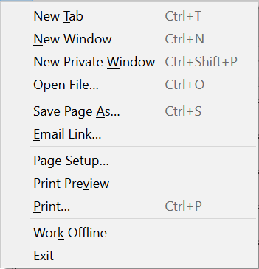
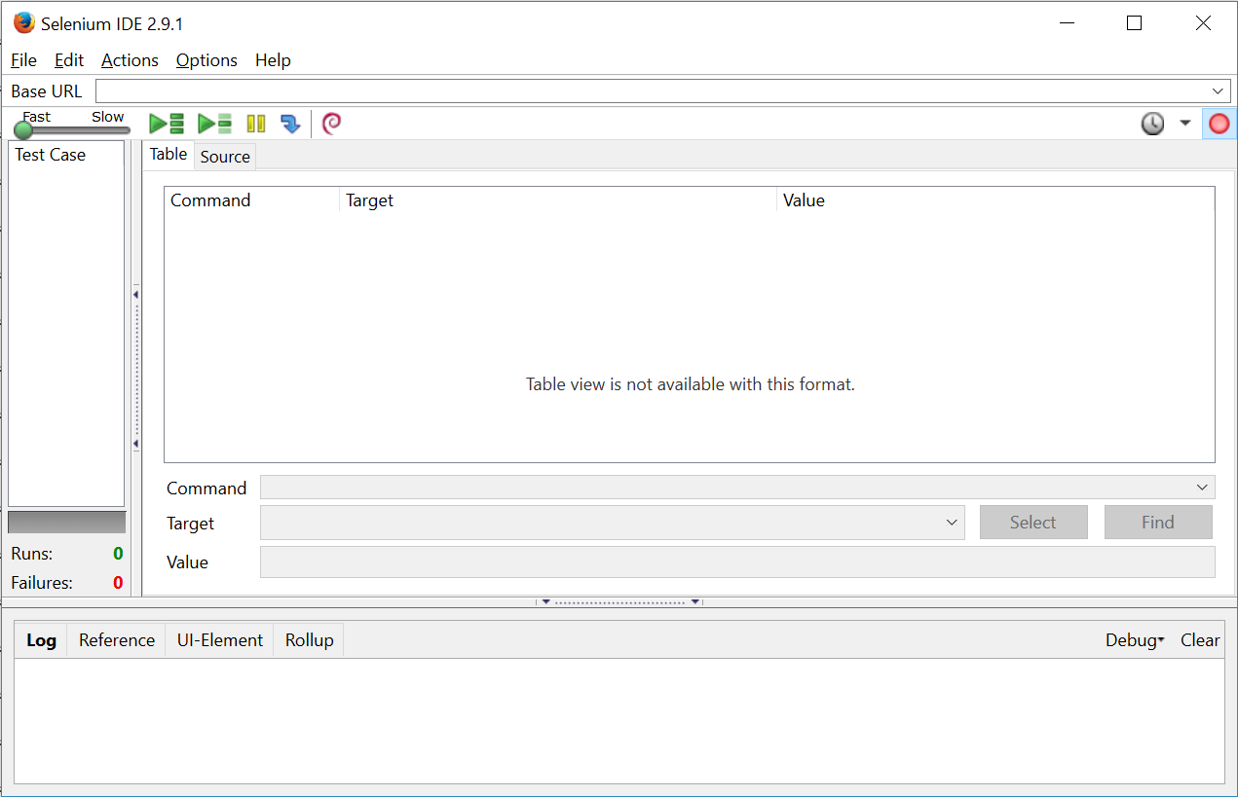
Running Scripts Manually
Project
Selenium
Test Suite
Script
Test Specification
Test Case
Downloads
Test Condition
Notes:
Running Scripts - Local

Slide 17

Running Scripts In The Cloud
Project
REST
Selenium
Test Suite
Script
Test Specification
Test Case
Test Condition
Notes:
Running Script - Cloud

Slide 18
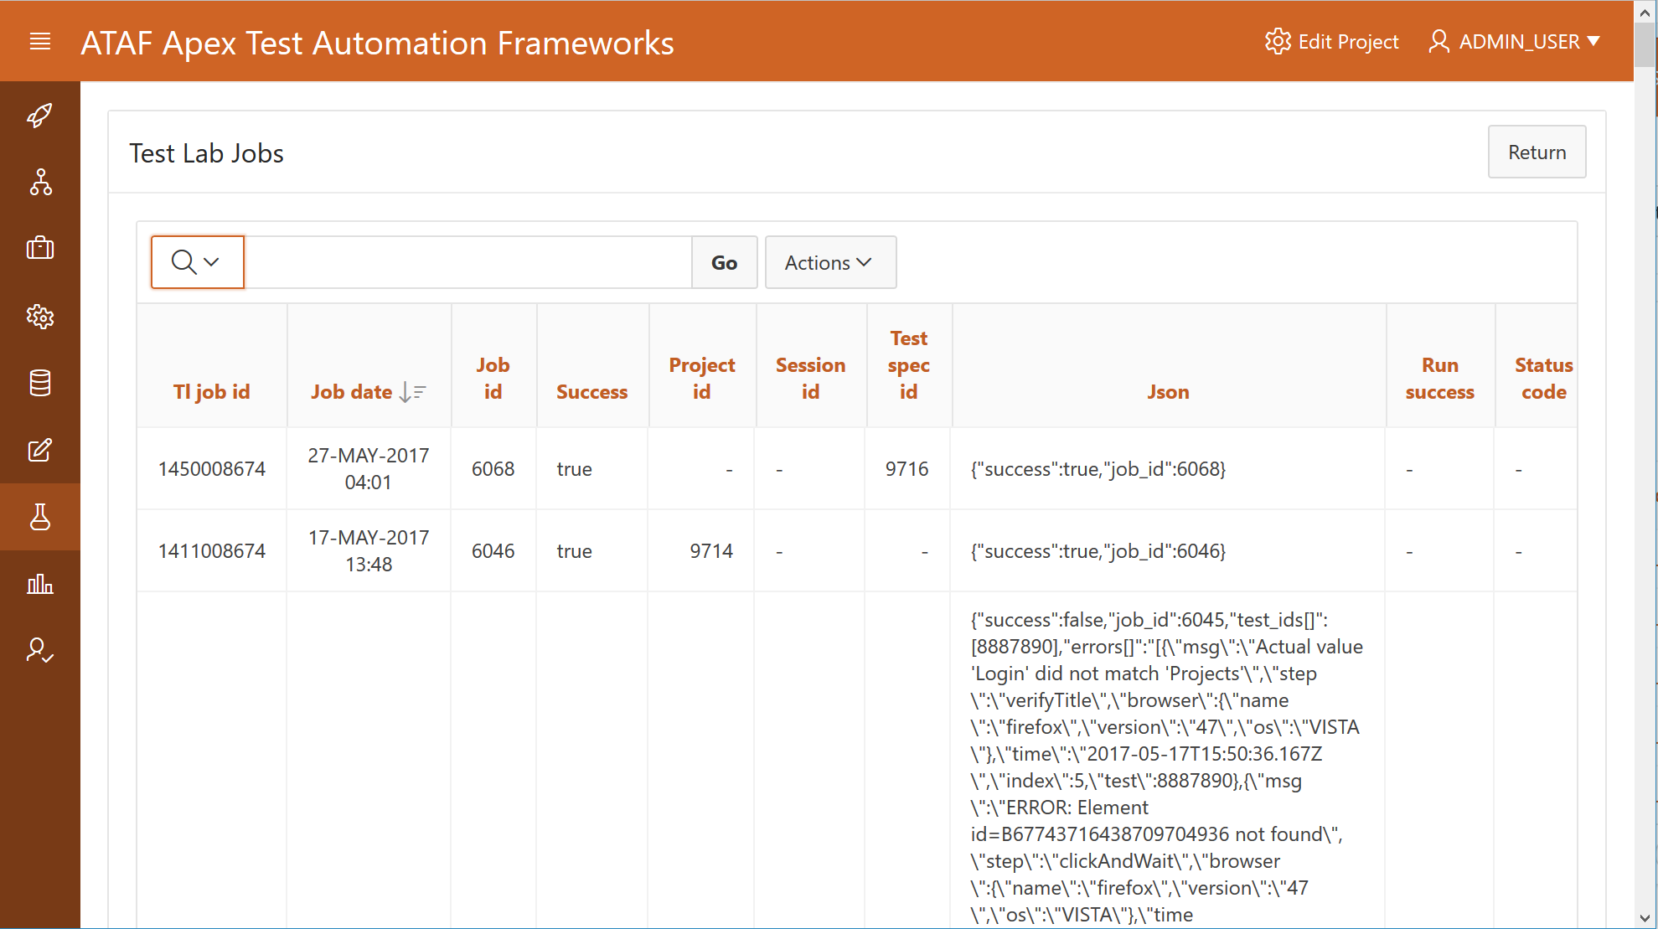
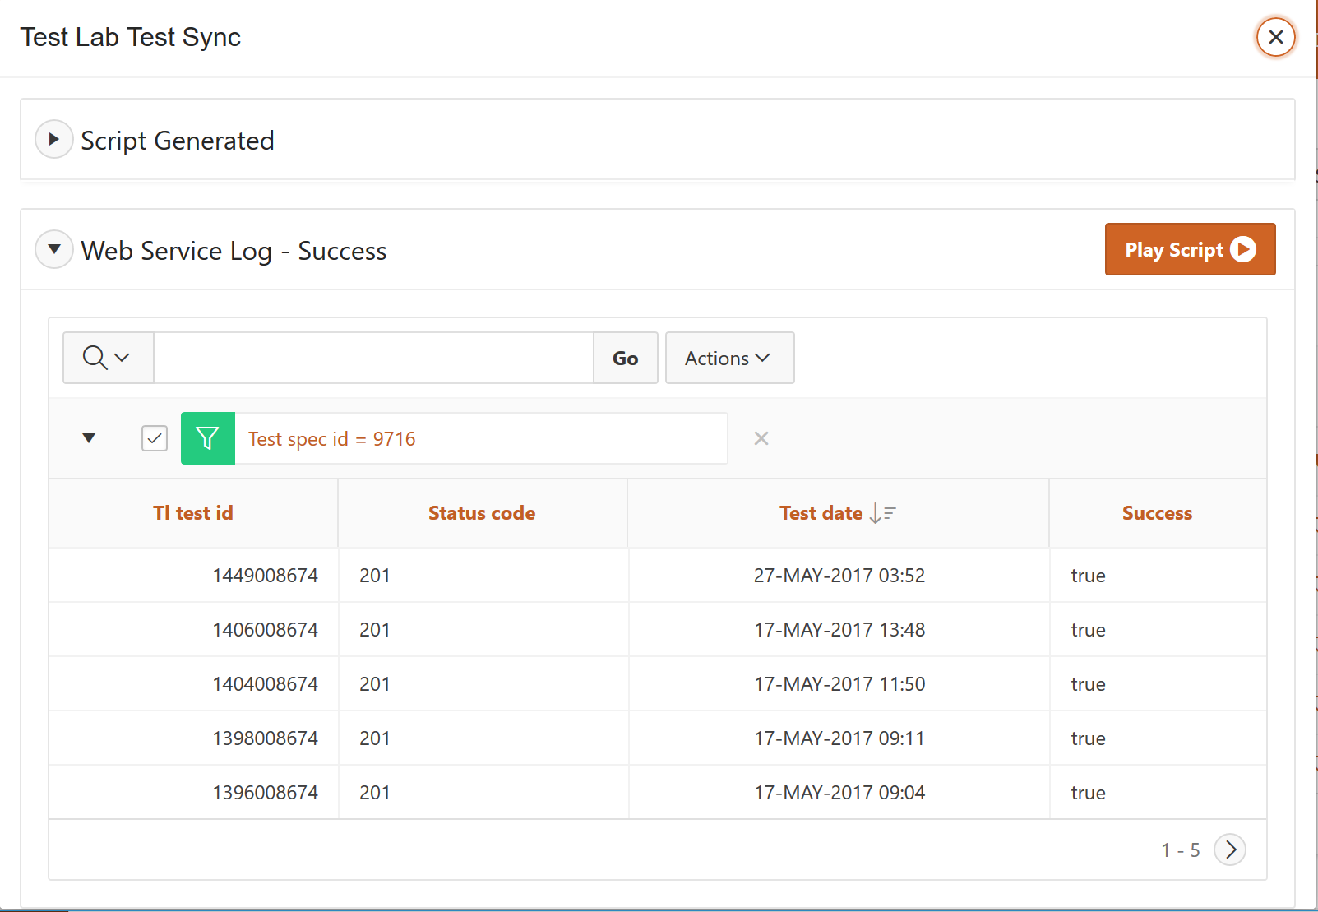
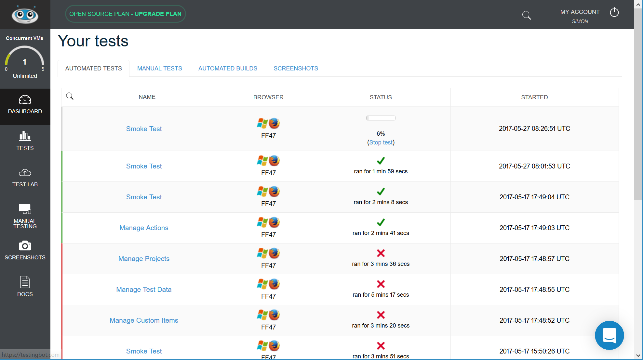
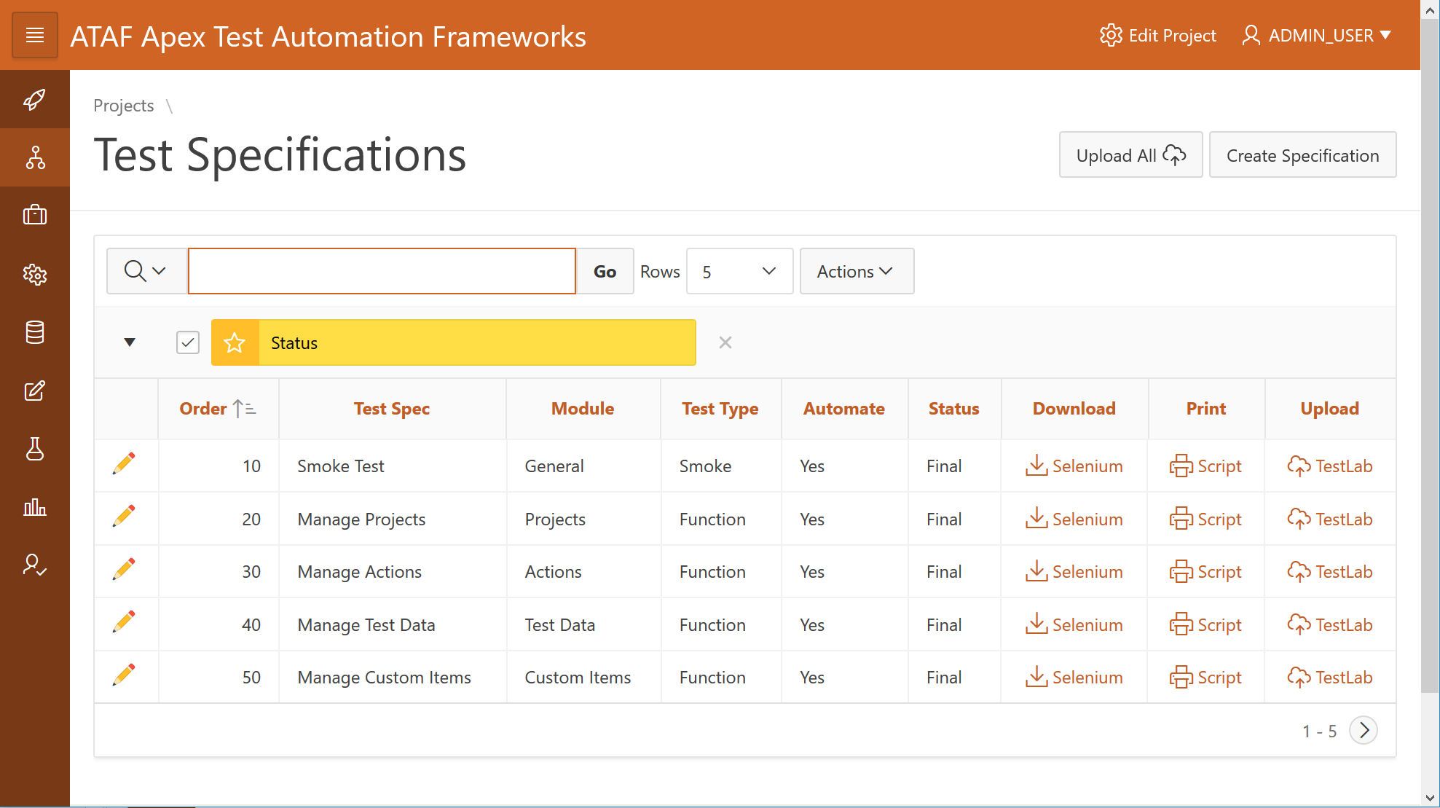
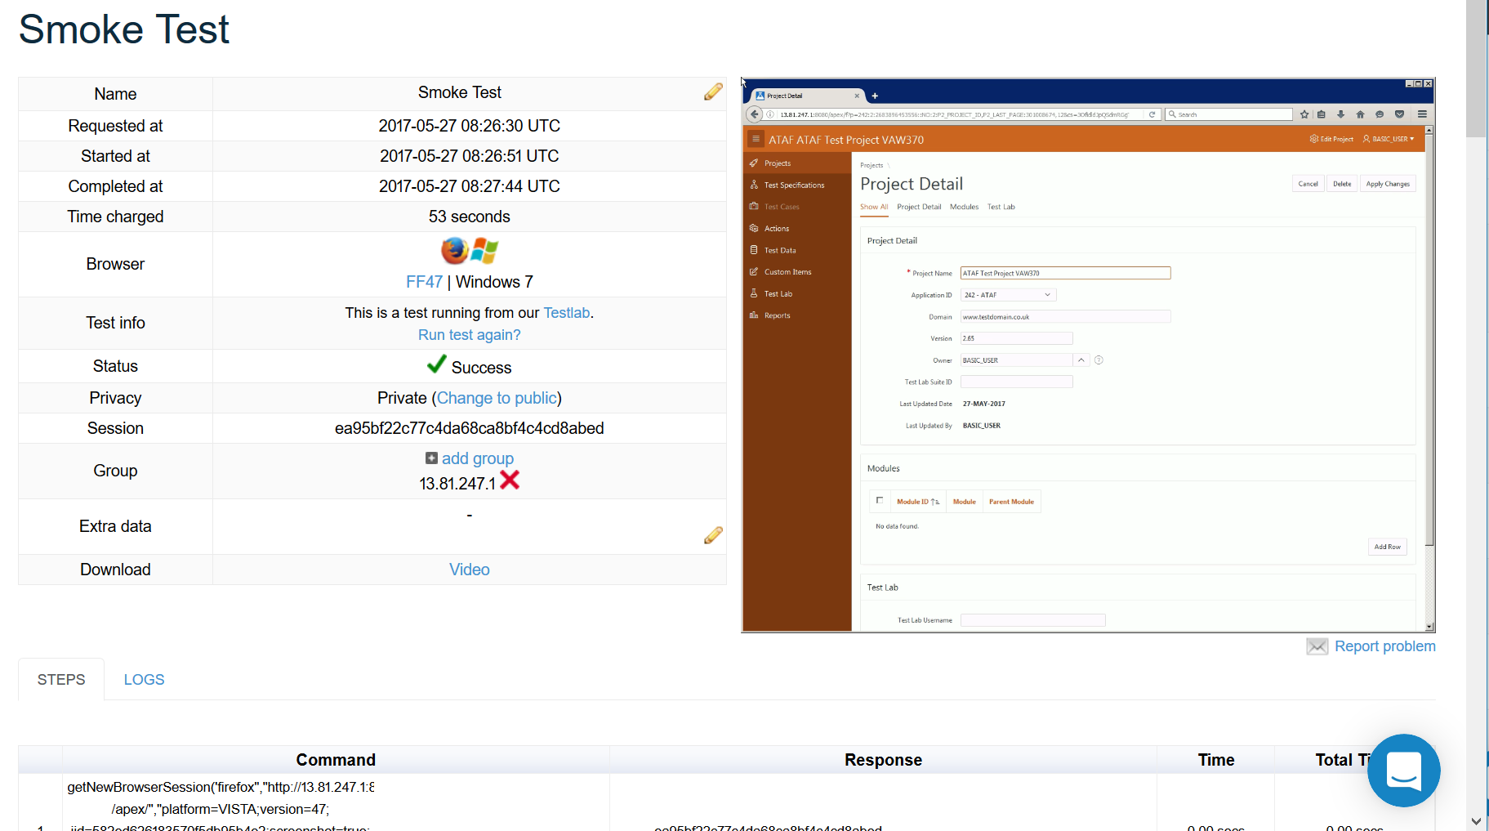
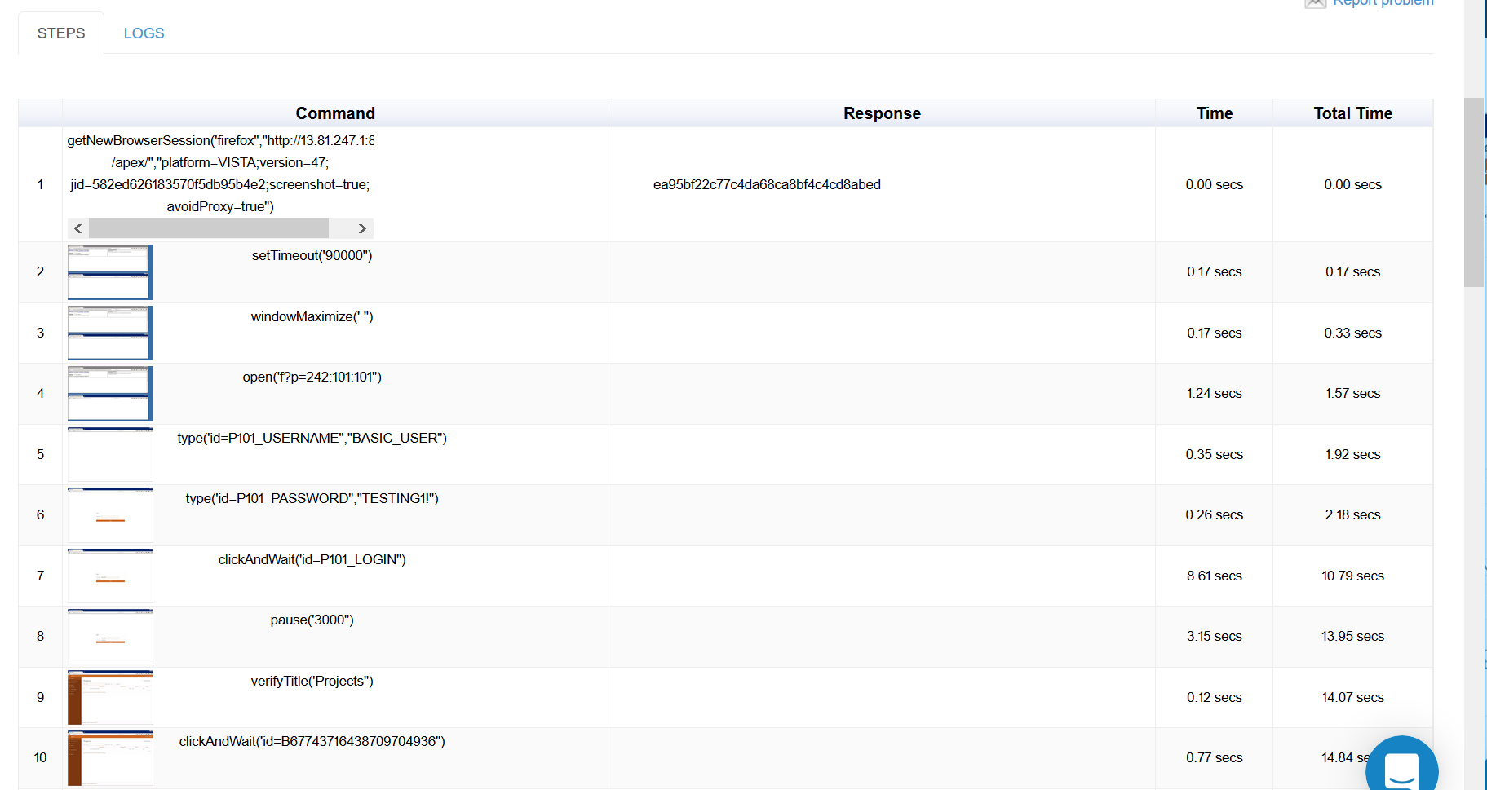
Running Scripts In The Cloud
Project
REST
Selenium
Test Suite
Script
Test Specification
Test Case
Test Condition
Notes:
Running Script - Cloud

Slide 19
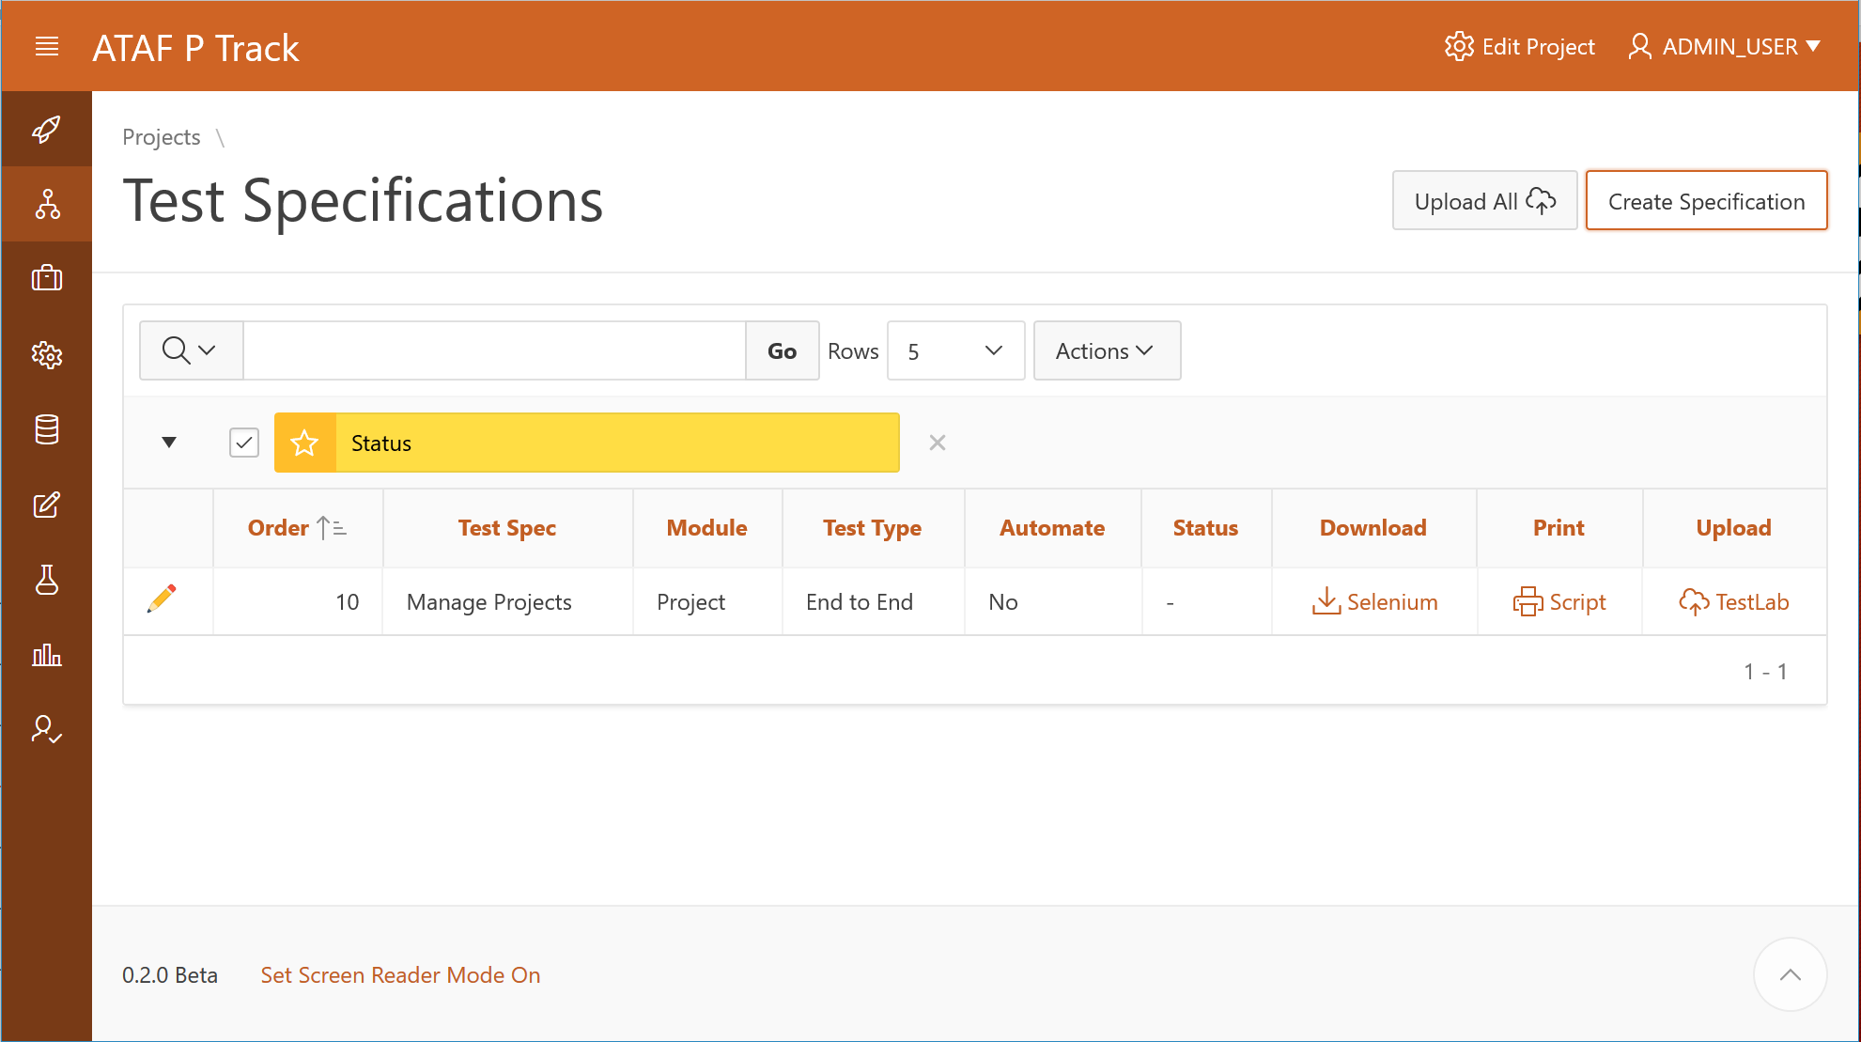
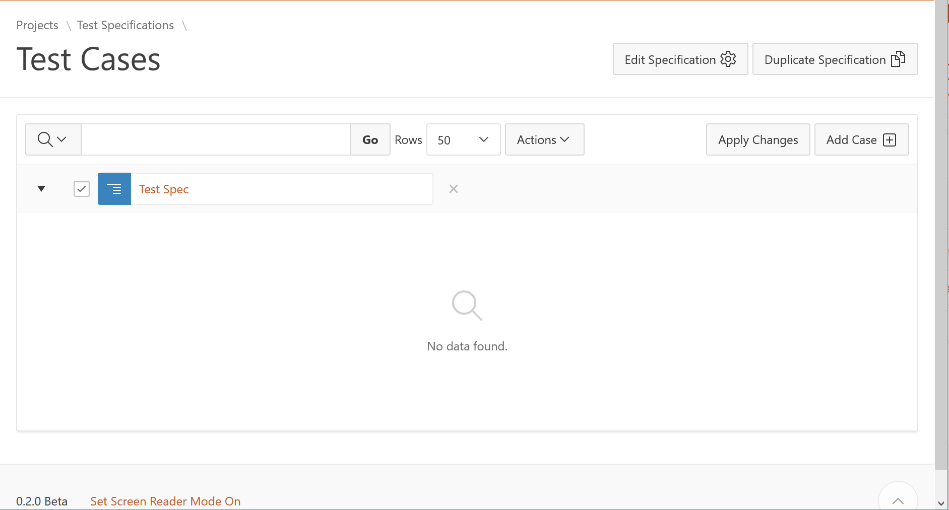
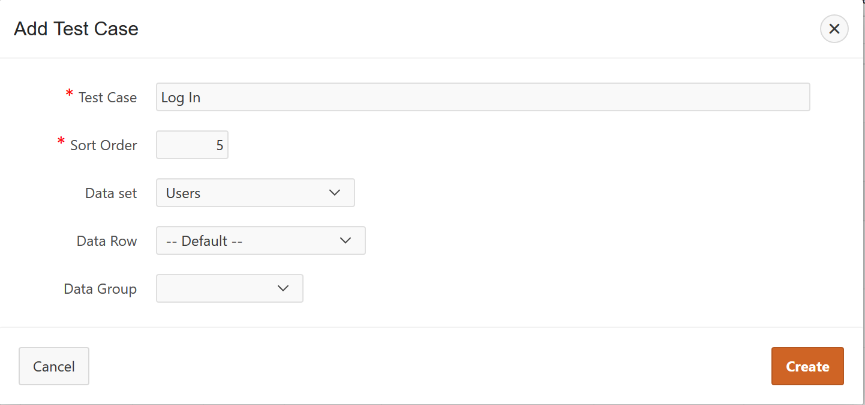
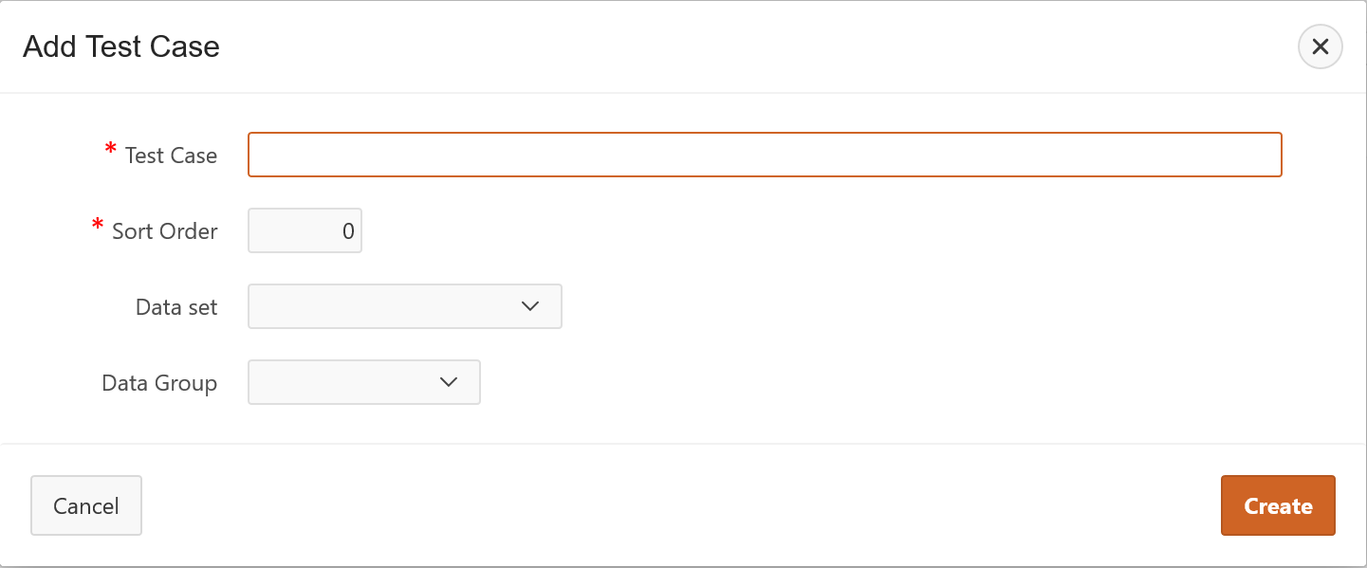
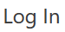
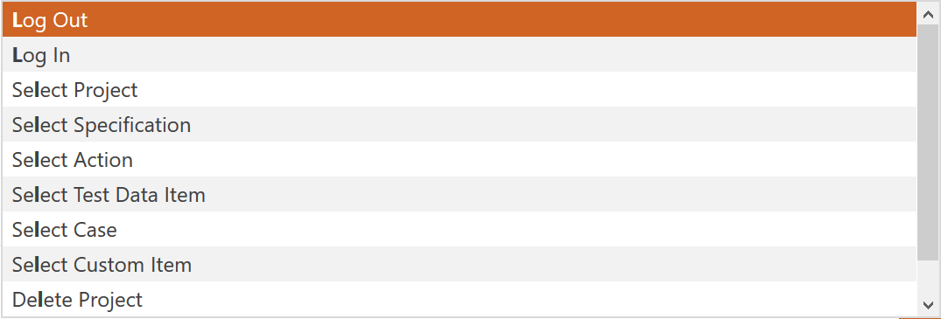
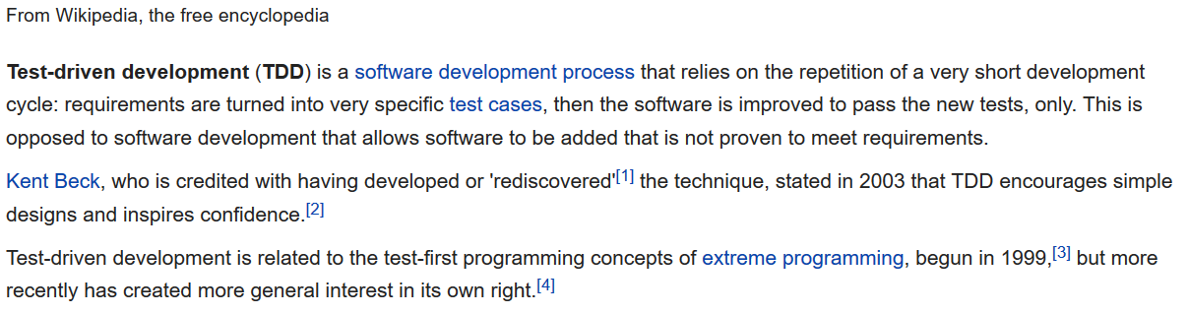
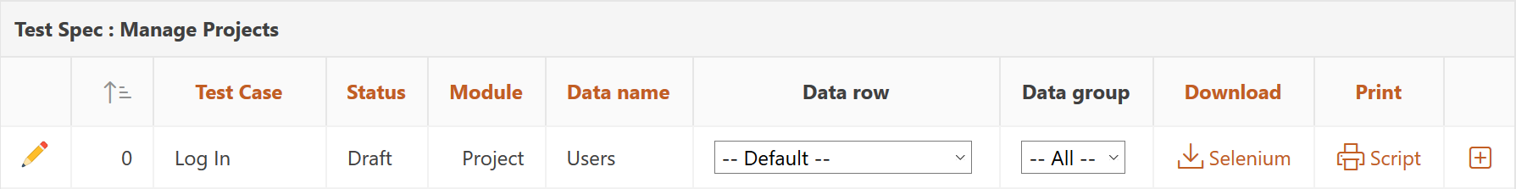
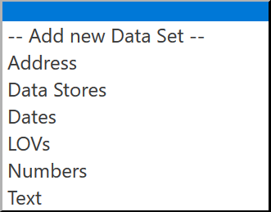
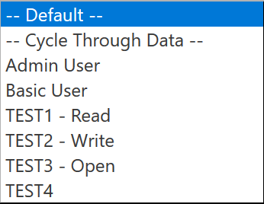
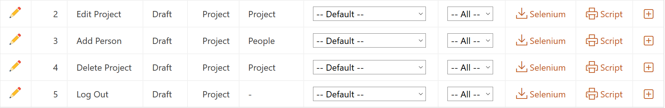
Test Driven Development
Notes:
Test Driven Development

Slide 20
Data Driven Testing
Bulk Data
Test Case
1 Default
2 Row 1
Data Set
2 Row 2
1 Row 3
Group
Attribute 1
Attribute 2
Attribute 3
Attribute n
Test Condition
Data Attribute
1 Row n
Notes:
Data Driven Testing

Slide 21
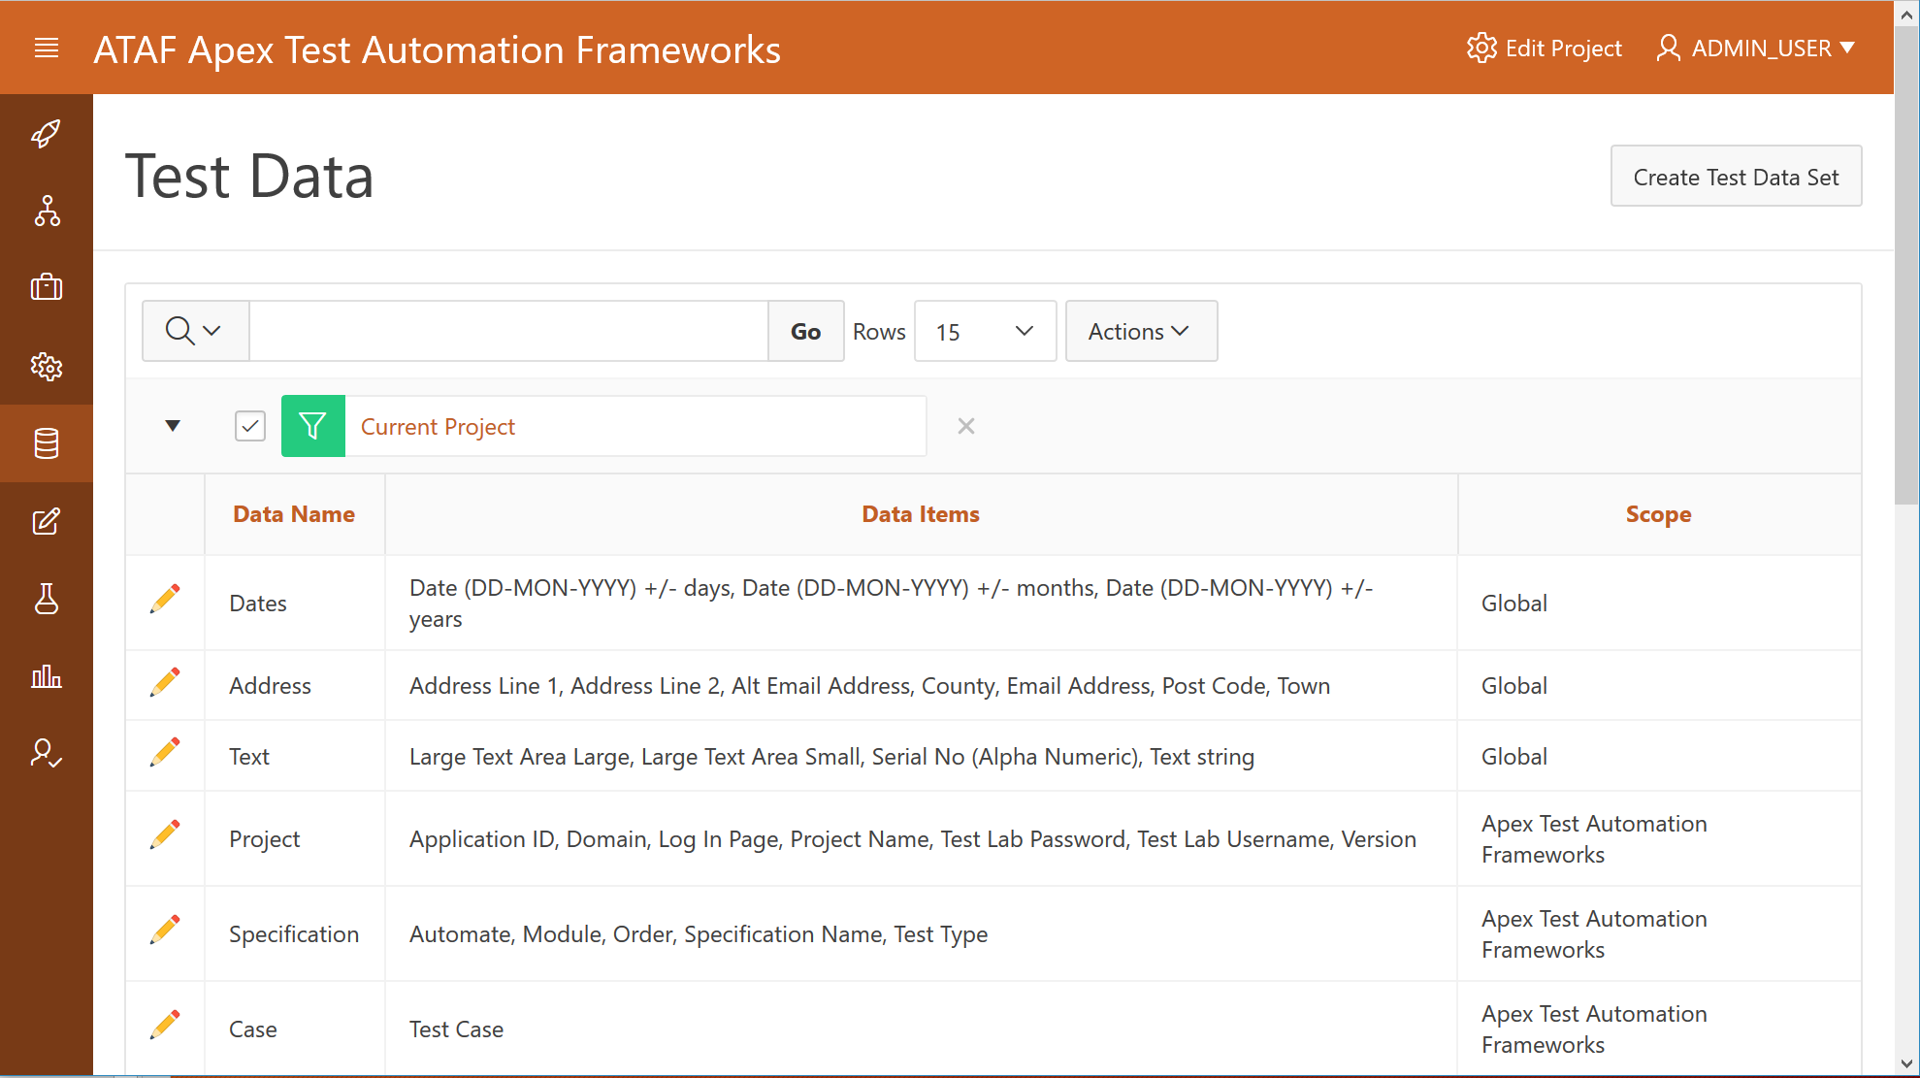
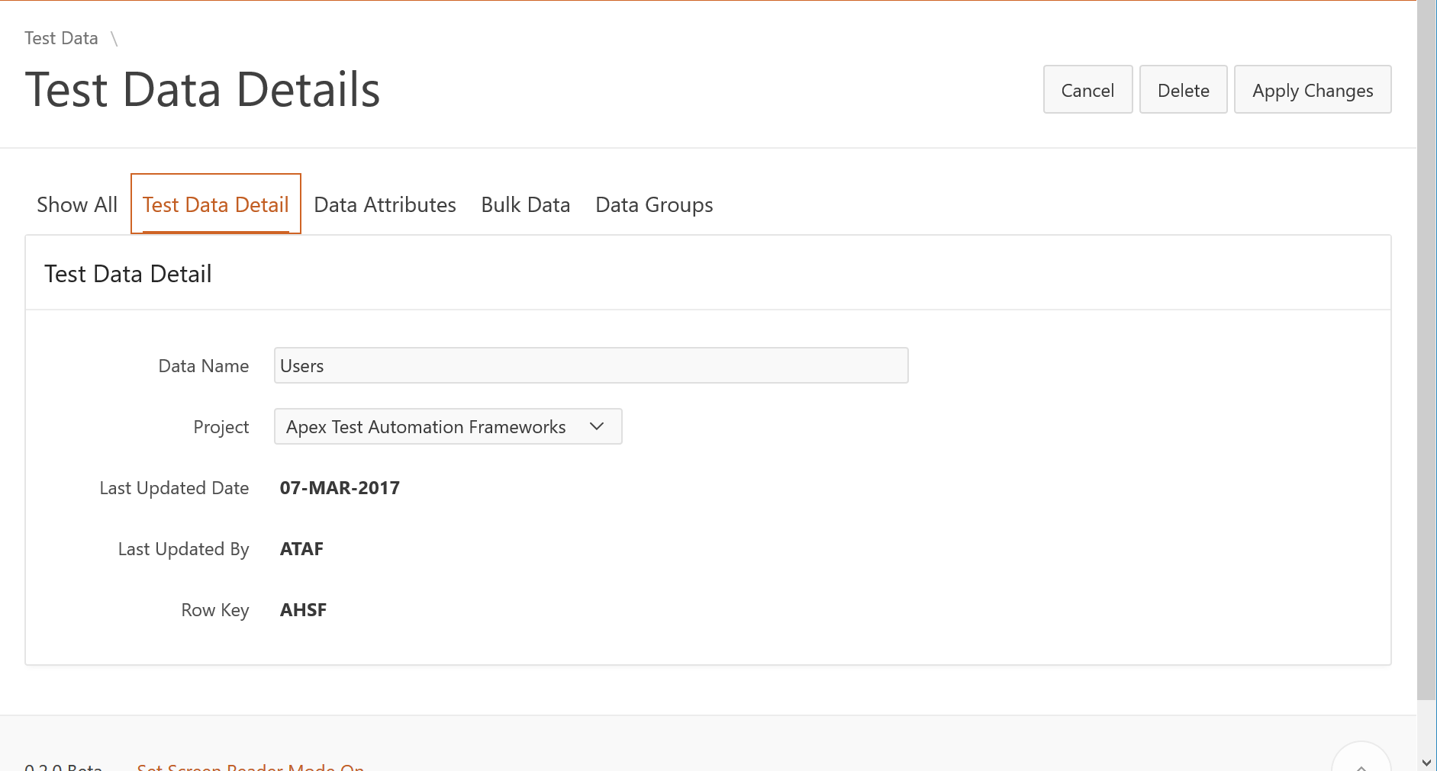
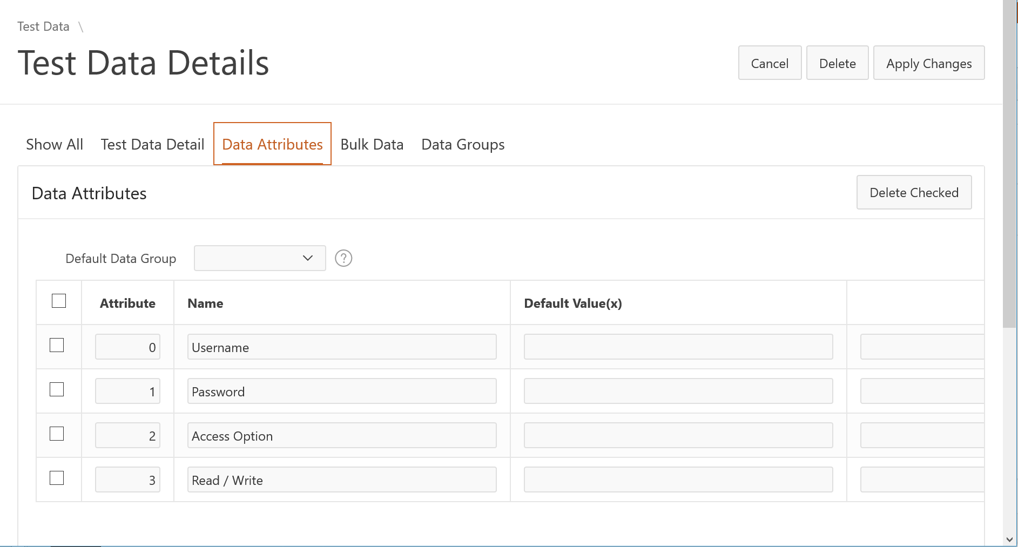
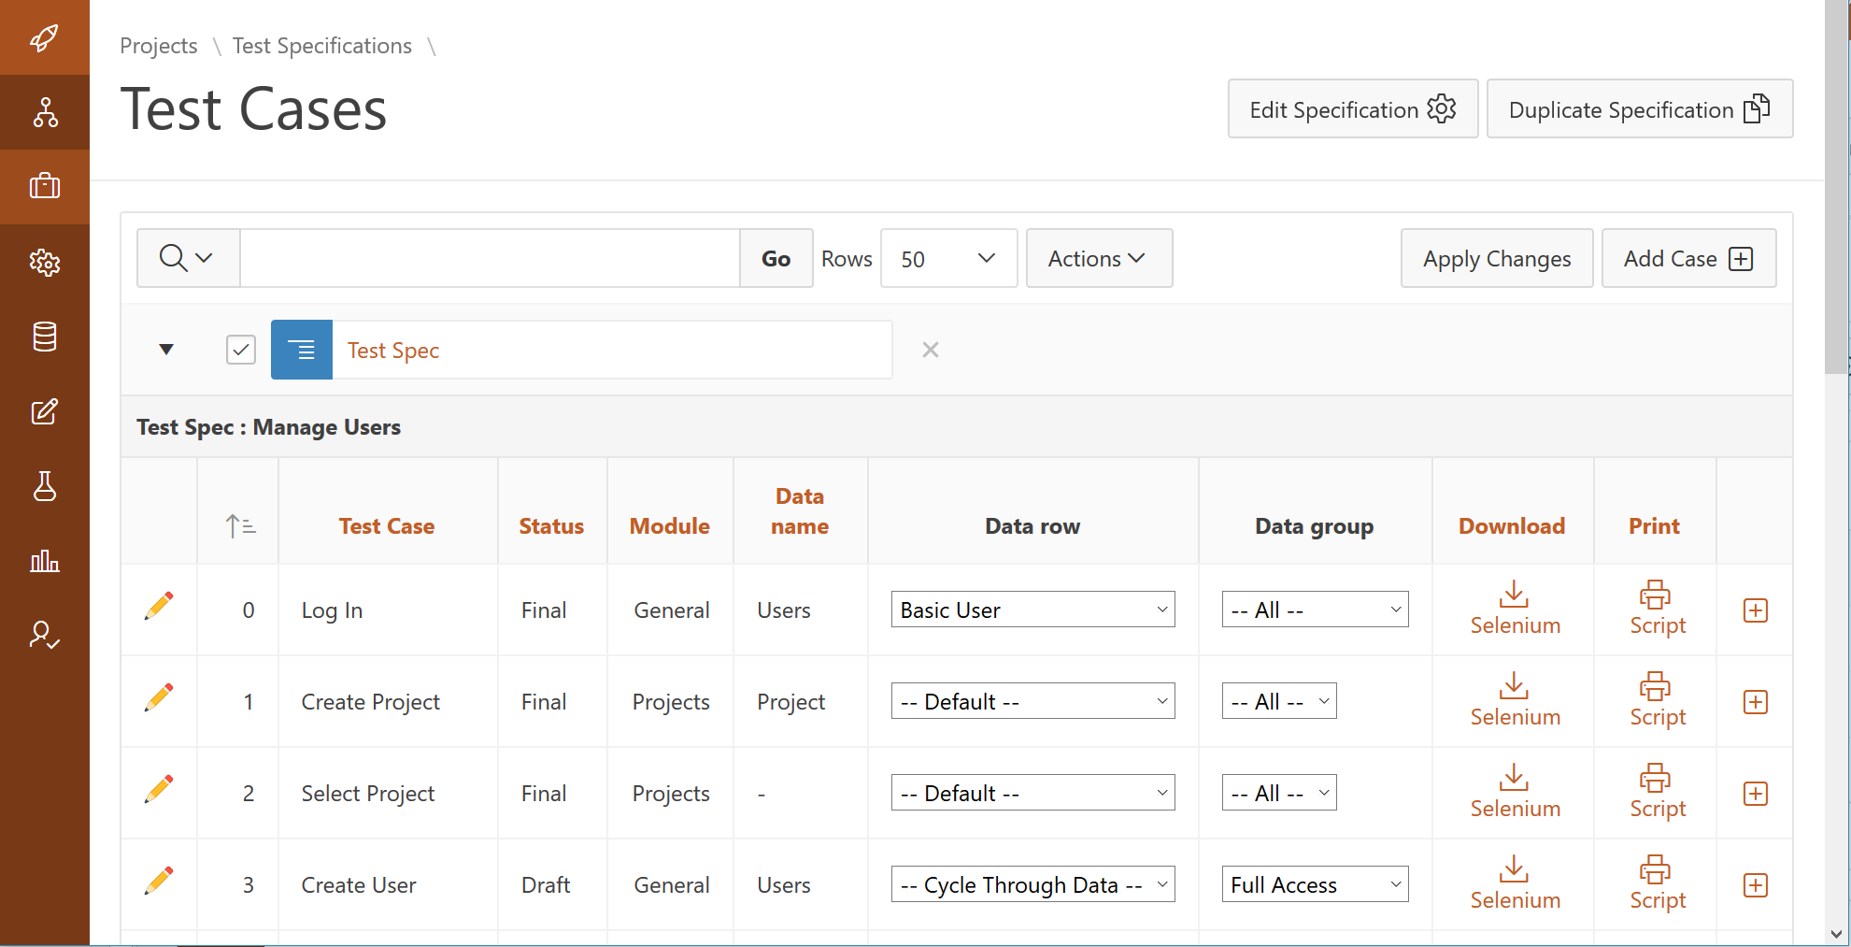
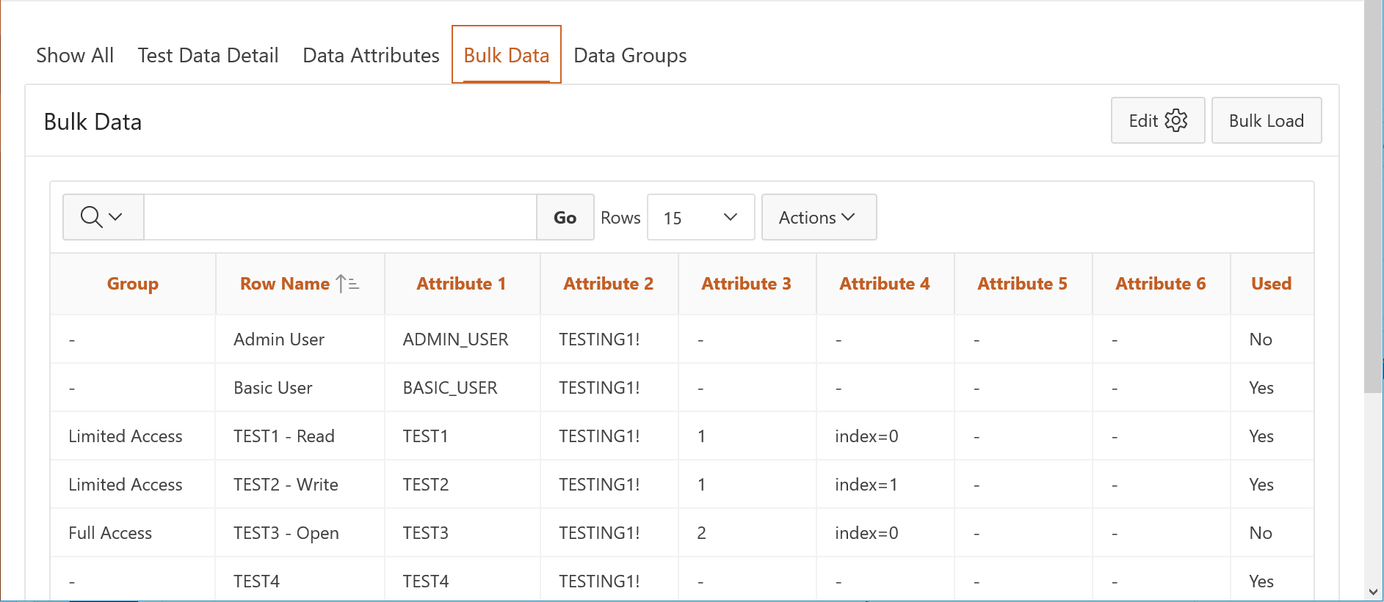
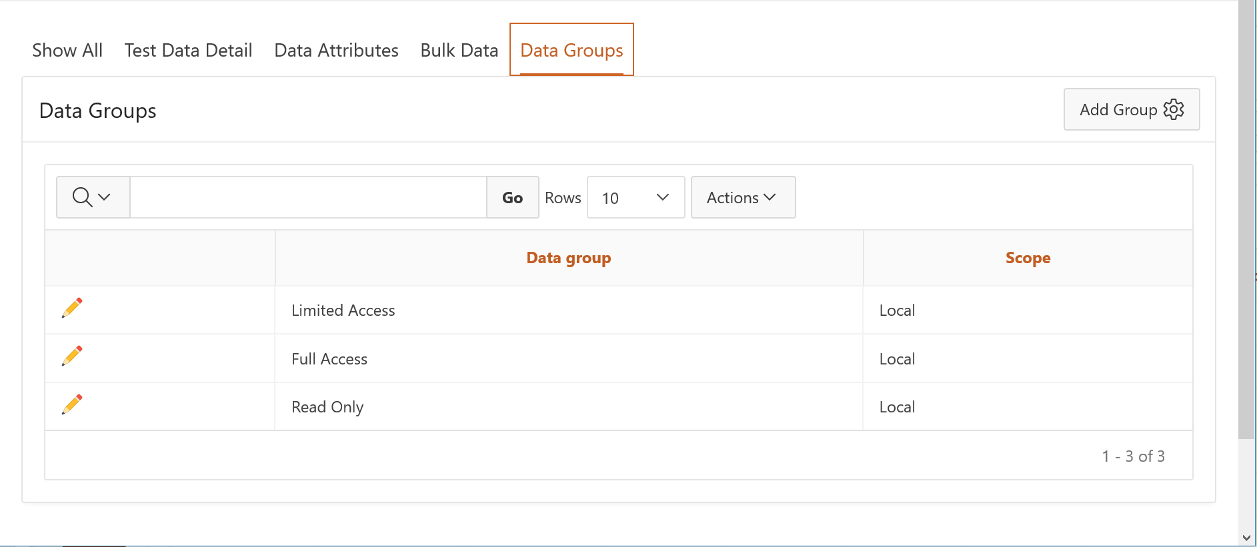
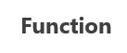
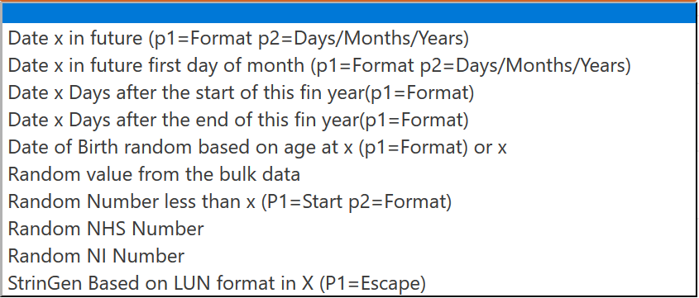
Data Driven Testing
Bulk Data
Test Case
1 Default
2 Row 1
Data Set
2 Row 2
1 Row 3
Group
Attribute 1
Attribute 2
Attribute 3
Attribute n
Test Condition
Data Attribute
1 Row n
Notes:
Data Driven Testing

Slide 22
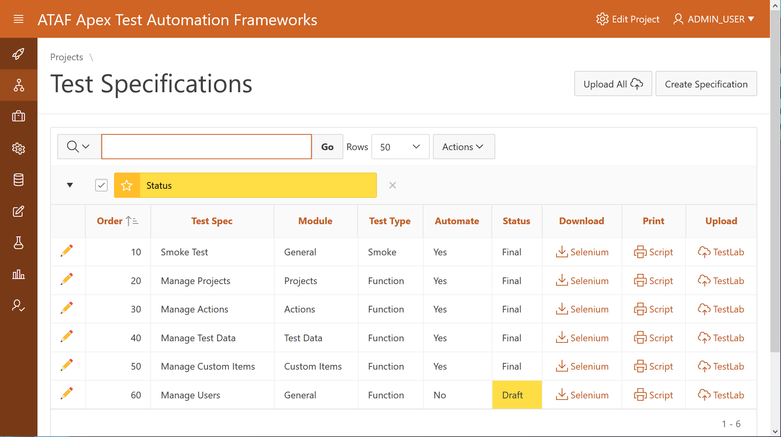
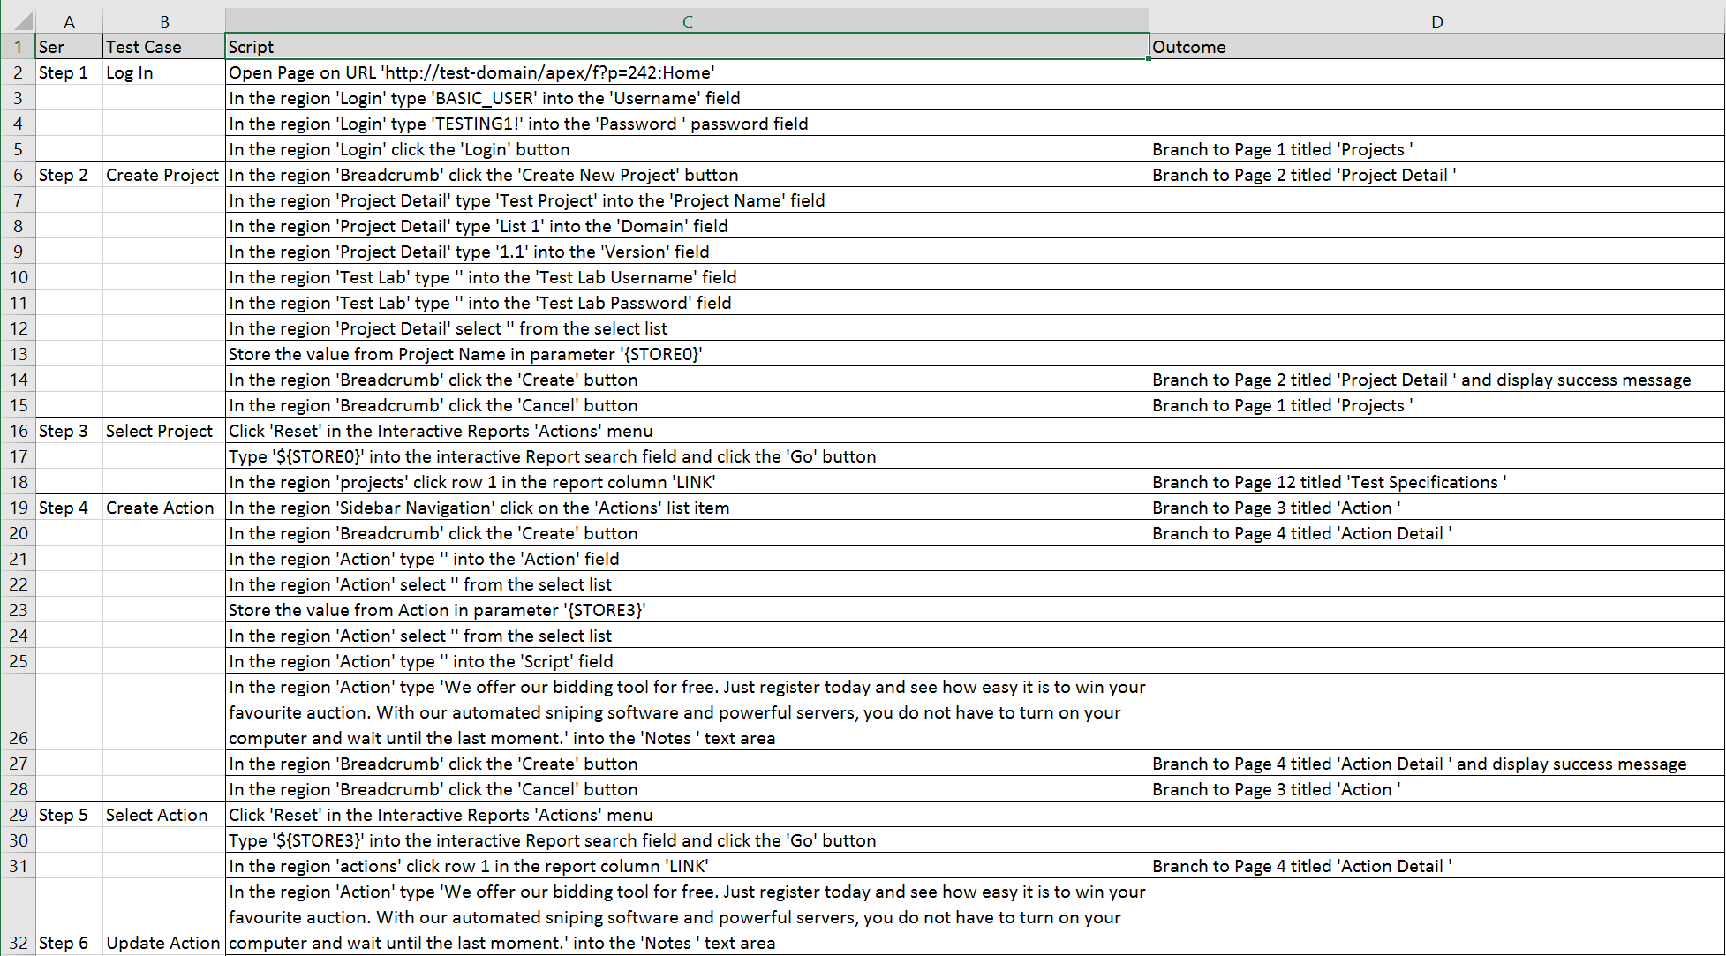
UAT Scripts
Project
UAT
Test Suite
Script
Test Specification
UAT
Test Case
Scripts
Test Case
Notes:
UAT Scripts

Slide 23
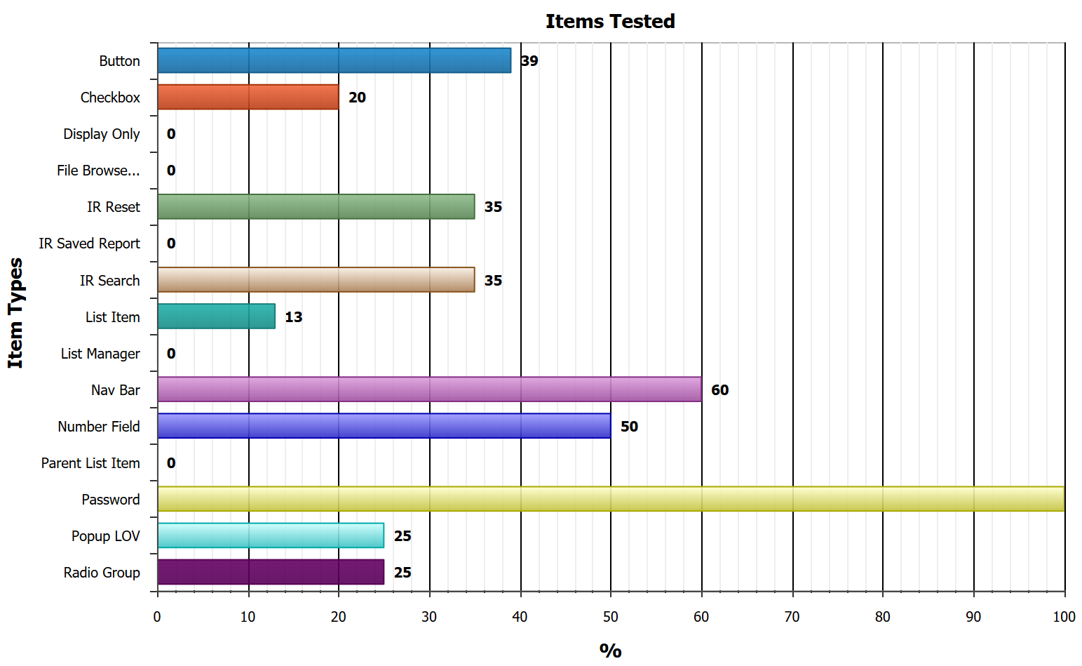
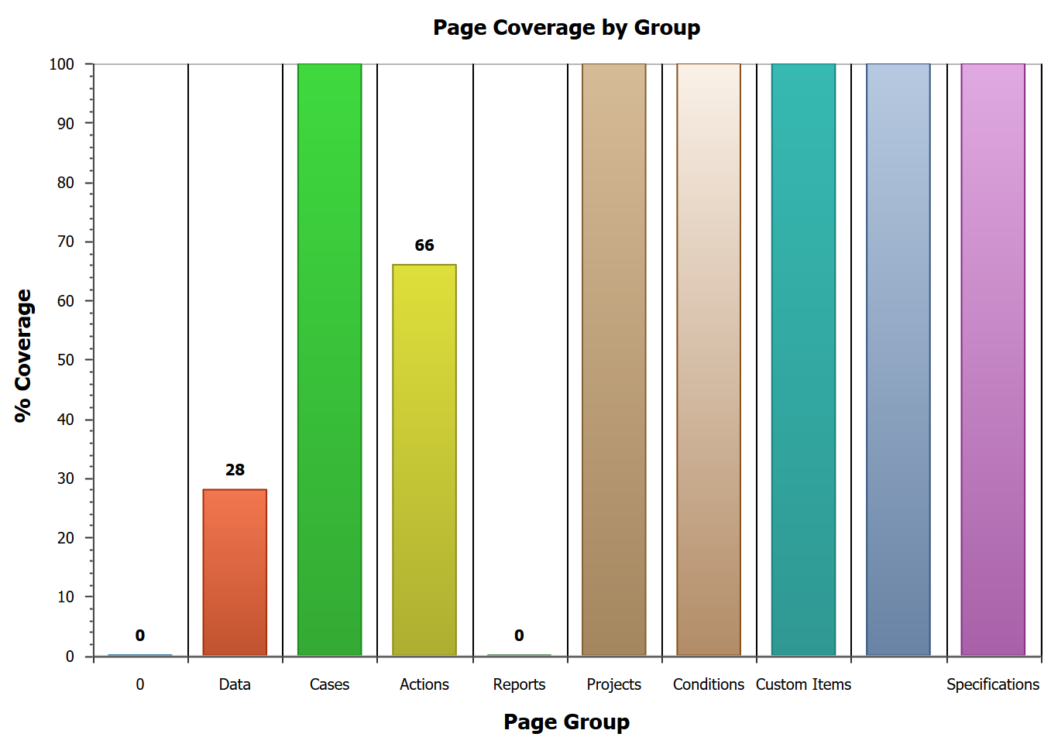
Reports
Notes:
Reports

Slide 24
Why Do I Need It?
For Agile Testing in Agile Delivery
For Quality Assurance
For Low Maintenance Scripts
Because it’s Easy to Use
Because it Requires No Additional Technical Skills (Low Code)
Because it’s Configurable And Can Be Adapted to Your Needs
To Keep Up With Apex Developers (SPEED)

Slide 25
Future Aspirations
This is a Title
Prev
Next
Cloud hosted version
Load and Performance Testing
Onboarding / Walkthrough / Tour integration
This is an Image
Prev
Next
Type Text Here
Prev
Next

